Slide 1


2019
Netcoreconf
Securing .Net Core APIs and WebApps with Azure Active Directory
Luis Mañez
Cloud Architect – ClearPeople LTD
@luismanez
26/01/2018

Slide 2

Securing .Net Core APIs and WebApps with Azure Active Directory

Slide 3
Sponsors

Slide 4


The Scenario
Sambori is a Toys manufacturing company that wants to allow their employees to Submit and Manage their expenses through different Apps.
They also need a tool for some Business users to manage and approve the different expenses.

Slide 5

The requirements
As a User, I want to be able to Submit my Expenses
As a User, I want to be able to see all my Expenses
As an Approver, I want to see all the Expenses in the system
As an Approver, I want to be able to approve or decline Expenses from any user
As an Admin, I want to see all the Expenses in the system
As an Admin, I want to be able to approve or decline Expenses from any user
As an Admin, I want to be able to Delete expenses from the system

Slide 6



The Users
Mary Jane Watson
IT Manager
Norman Osborn
Finance Accountant
Felicia Hardy
Sales

Slide 7


Solution Architecture
Azure Active Directory
Expenses Management
Web App
Expenses
graph.microsoft.com
End Users
WebAPI
Expenses
Lite
Web App

Slide 8


The Protocols
oAuth2
Provides Authorization framework
OpenIdConnect
Built on top of oAuth 2
Provides Authentication capabilities
/UserInfo endpoint
IdToken
Discovery service
/Authorize endpoint
Access Token
/Token endpoint
Refresh Token

Slide 9









The Players
Client (AKA App)
Public: native, mobile, user agent
Confidential: server
Authorization Server
Resource Owner
(AKA User)
Resource Server

Slide 10
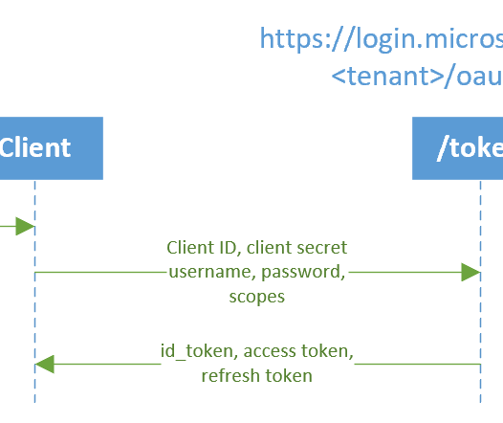
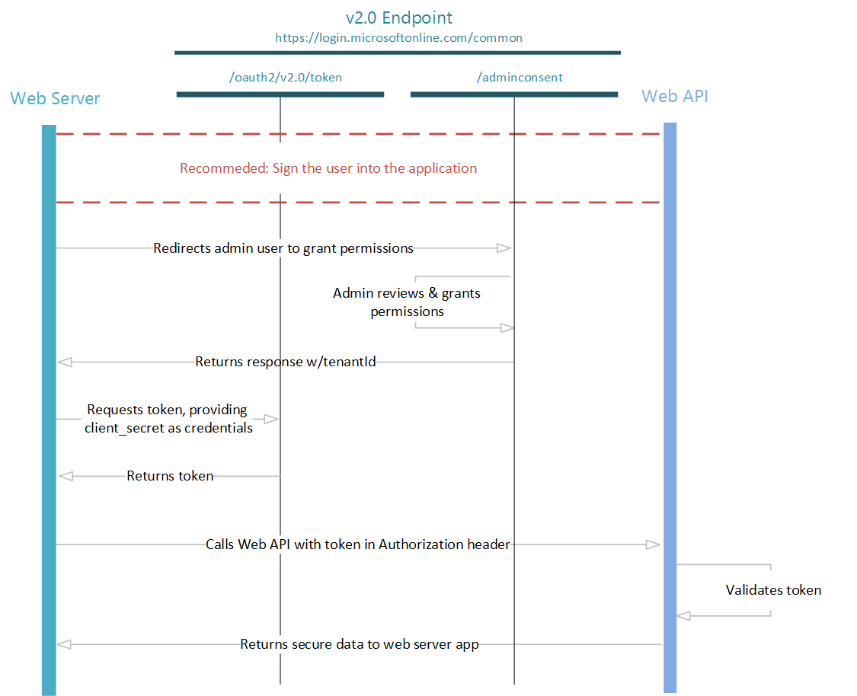
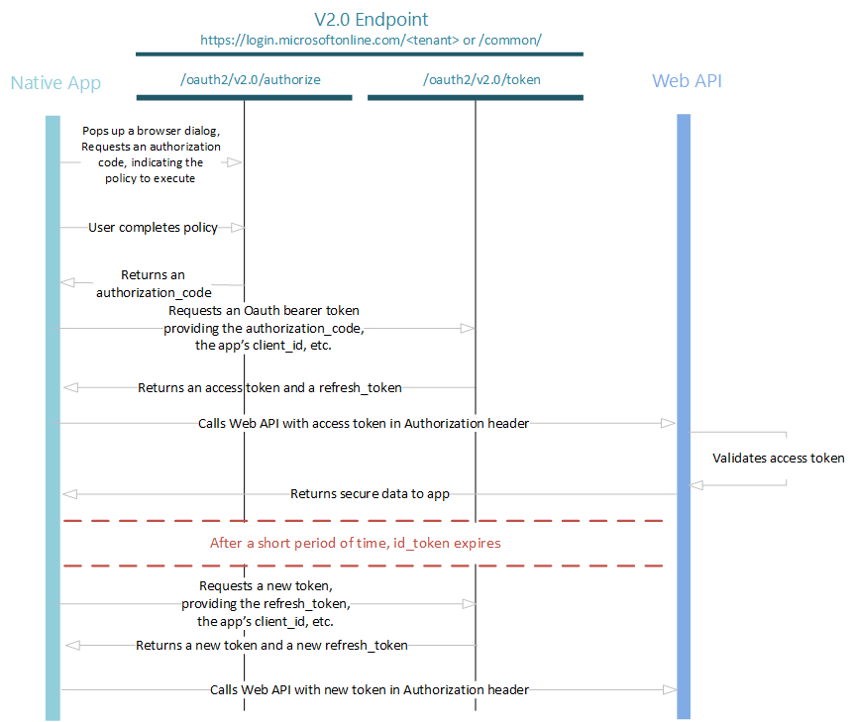
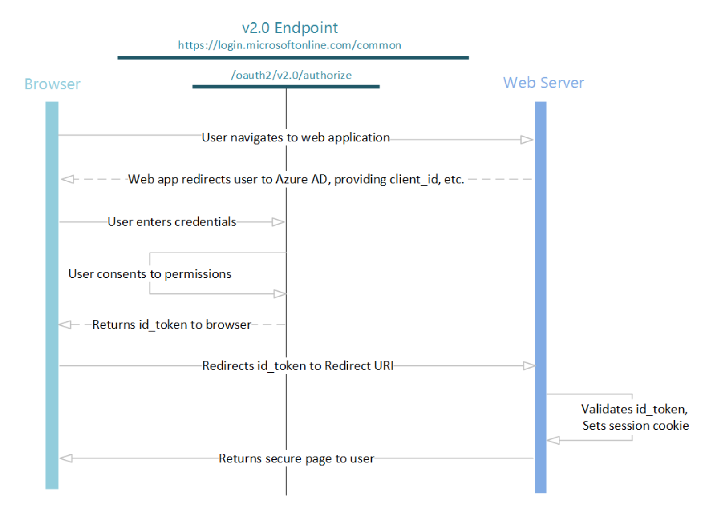
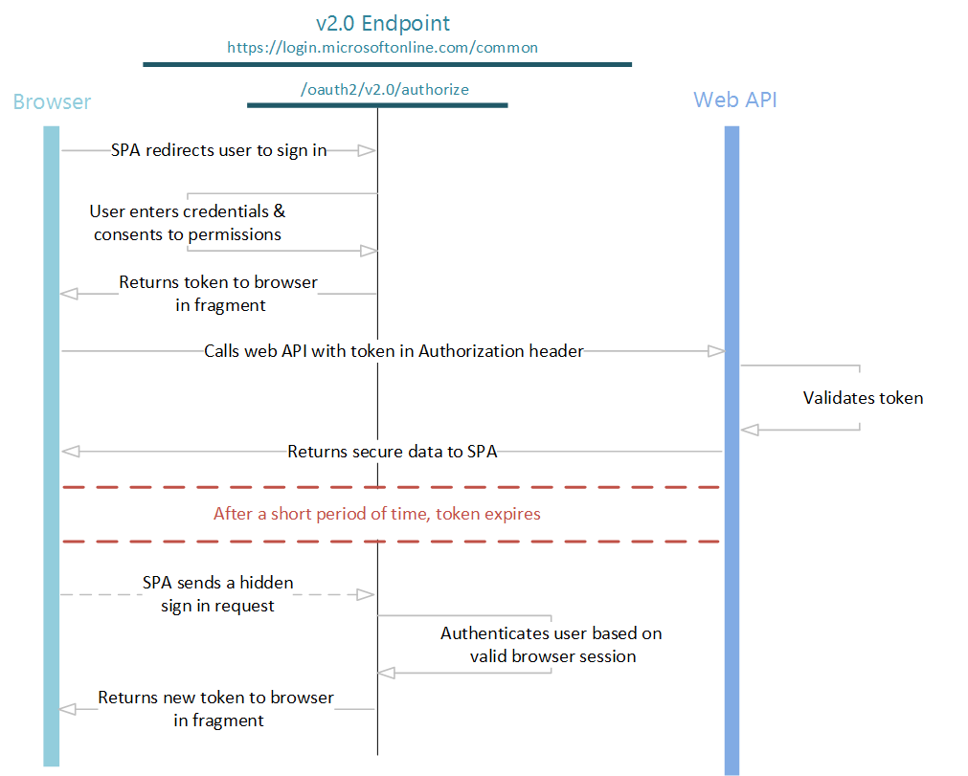
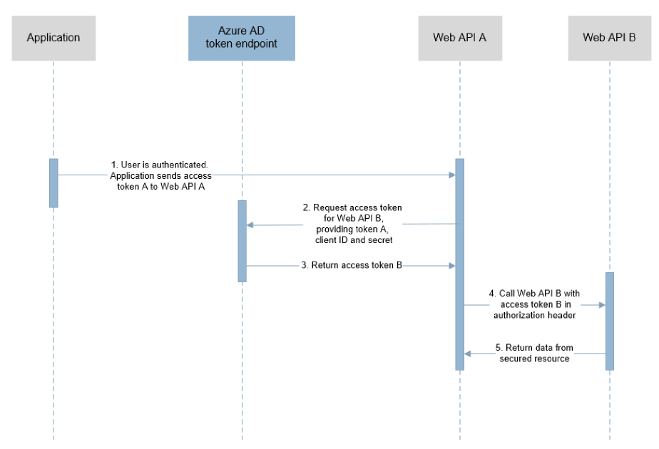
The Flows in Azure AD v2
Open ID Connect (Sign in) Flow
OAuth 2.0 Auth code grant
OAuth 2.0 Implicit grant
Oauth 2.0 On-behalf-of
Oauth 2.0 Client Credentials
Oauth 2.0 Resource Owner password credentials grant
Refresh Token
Device Code Flow (personal accounts NOT supported)

Slide 11
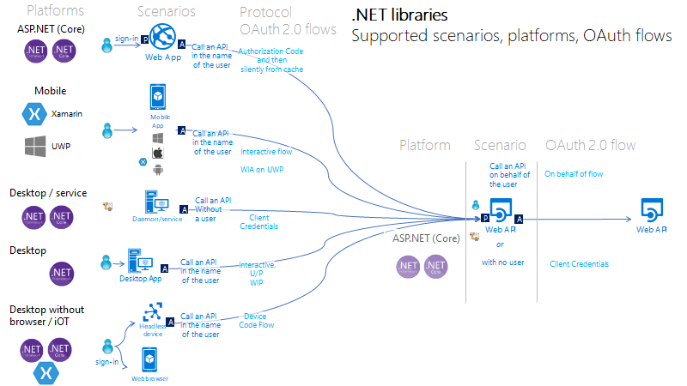
https://github.com/AzureAD/microsoft-authentication-library-for-dotnet/wiki/scenarios

Slide 12
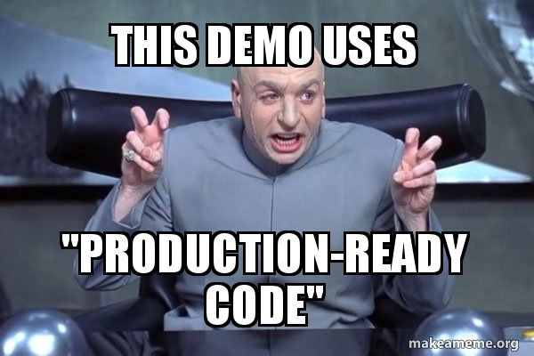
Demo

Slide 13
https://github.com/luismanez/netcoreconfbcn2019

Slide 14
Resources
Azure AD V2 Getting Started:
https://docs.microsoft.com/en-us/azure/active-directory/develop/v2-overview
Azure AD V2 Samples directory:
https://docs.microsoft.com/en-us/azure/active-directory/develop/sample-v2-code
Azure AD V2 and MSAL from dev side:
https://joonasw.net/view/azure-ad-v2-and-msal-from-dev-pov
oAuth2 Grants guide:
https://alexbilbie.com/guide-to-oauth-2-grants/
oAuth2 Flow diagrams and videos:
https://medium.com/@darutk/diagrams-and-movies-of-all-the-oauth-2-0-flows-194f3c3ade85
Other stuff related with the session:
https://github.com/AzureAD/microsoft-authentication-library-for-dotnet/wiki/Adal-to-Msal
https://docs.microsoft.com/en-us/azure/active-directory/develop/sample-v2-code
https://github.com/AzureAD/microsoft-authentication-library-for-dotnet/wiki/scenarios
https://azure.microsoft.com/en-us/resources/samples/active-directory-dotnet-webapi-onbehalfof/

Slide 15
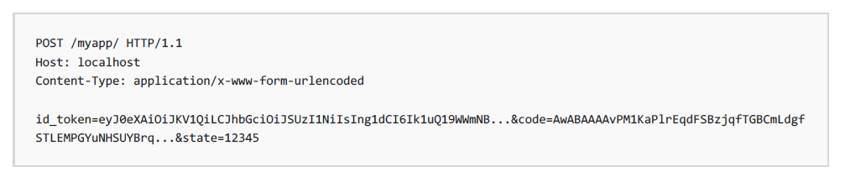
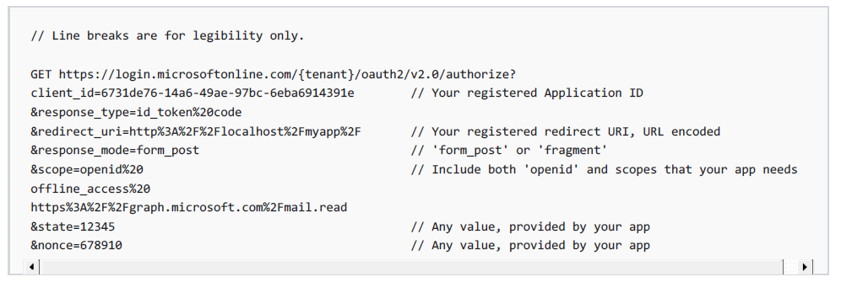
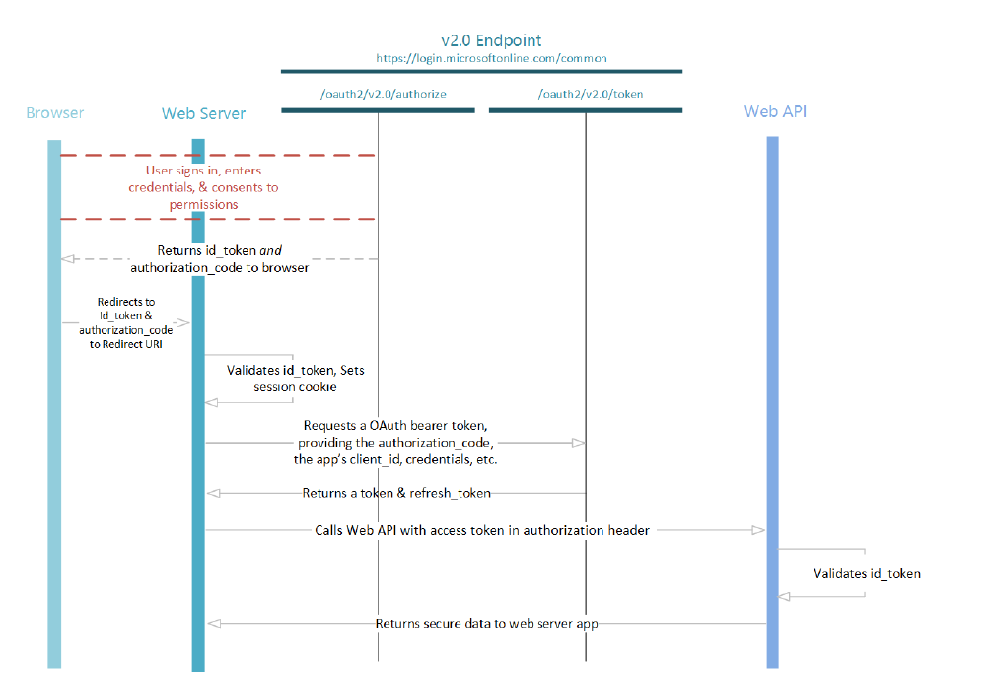
Apendix: Azure AD V2 Flow Diagrams

Slide 16
Azure AD Sign In Flow

Slide 17
Azure AD Sign In Flow

Slide 18
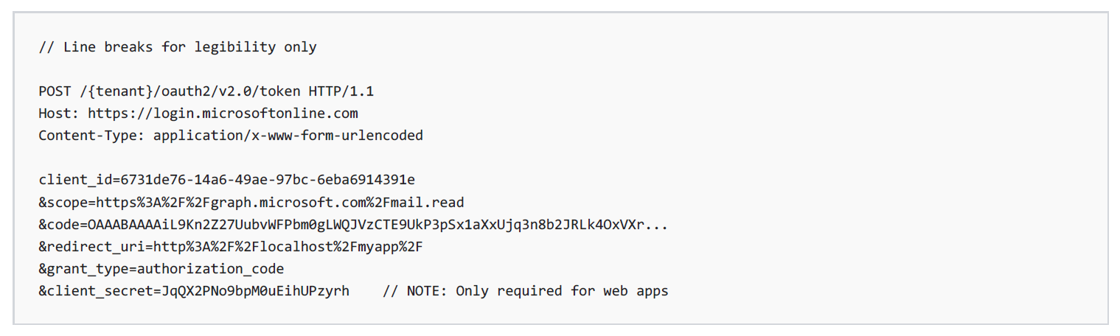
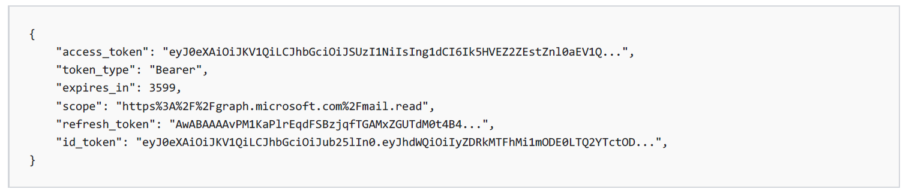
Azure AD Authorization Code Flow

Slide 19
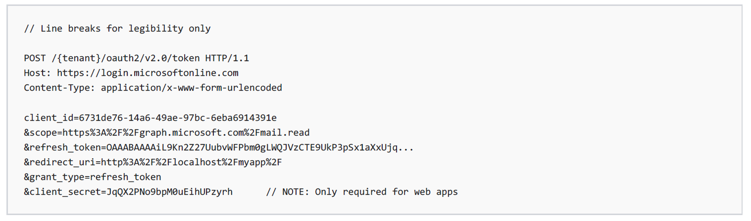
Azure AD Refresh Token

Slide 20
Azure AD On-Behalf-Of Flow

Slide 21
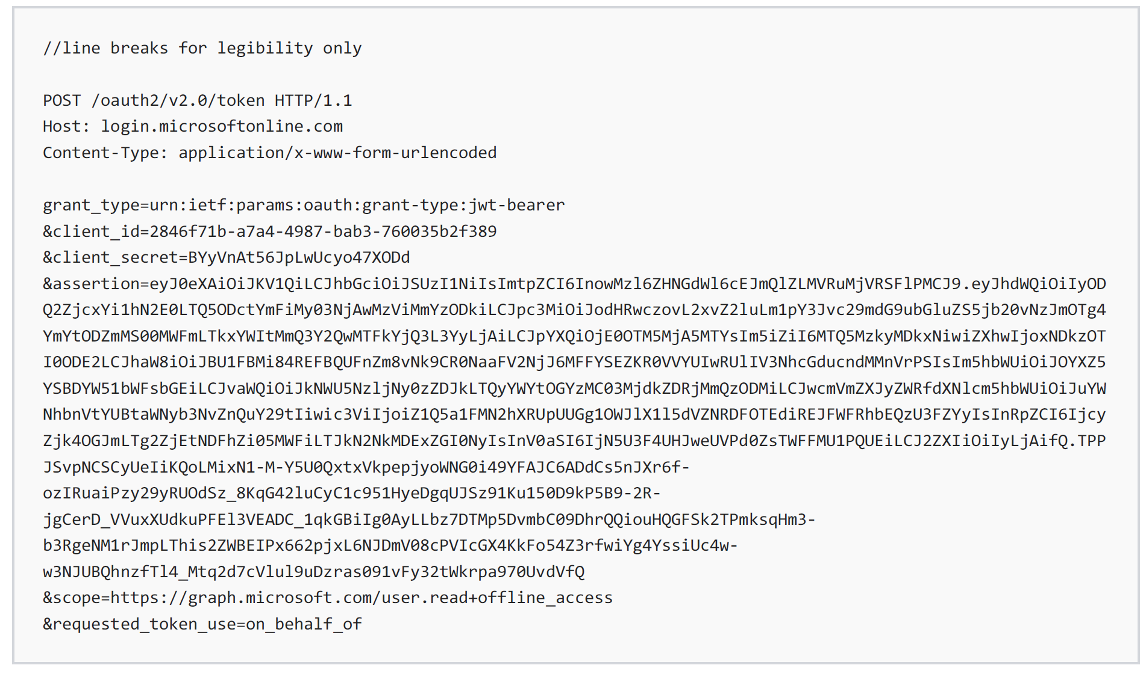
Azure AD On-Behalf-Of Flow

Slide 22
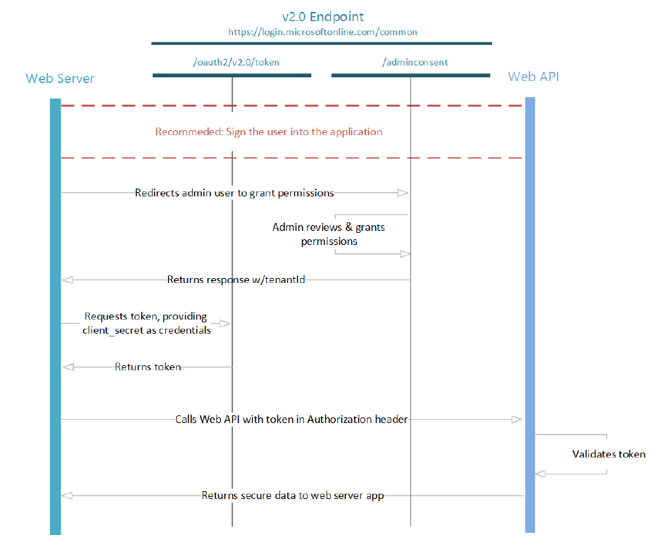
Azure AD Client Credentials Flow

Slide 23
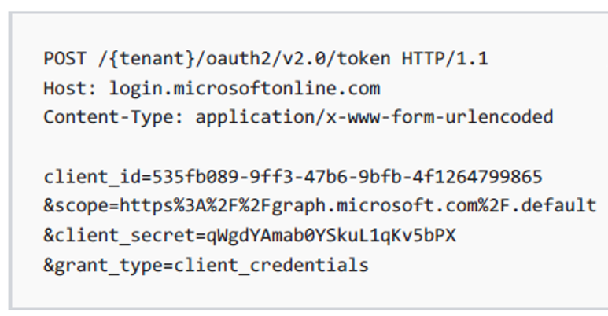
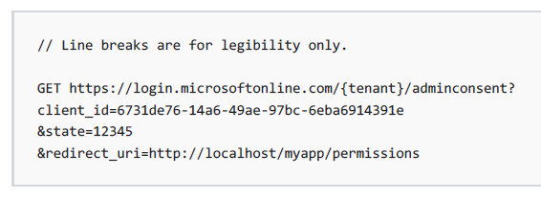
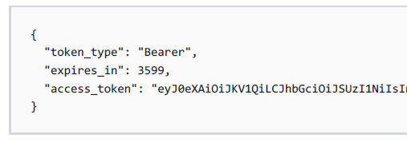
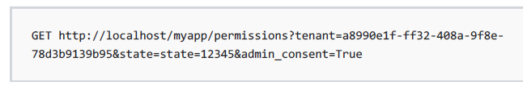
Azure AD Client Credentials Flow
Get Token
Admin consent
No Refresh Token!

Slide 24
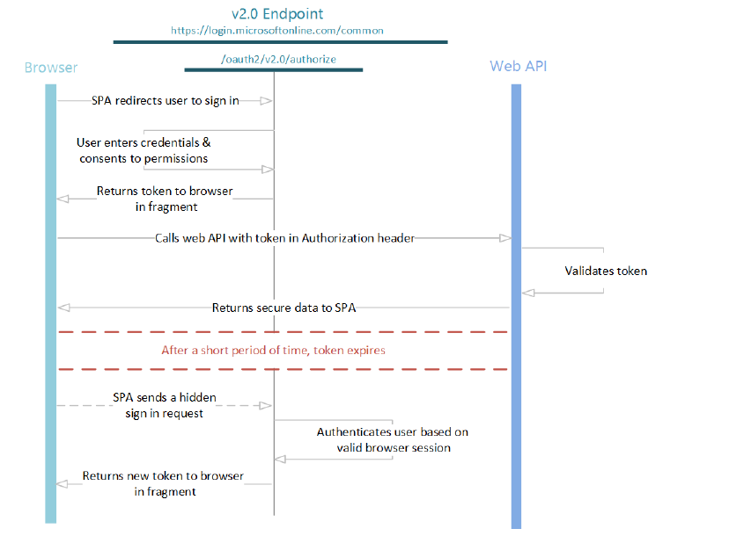
Azure AD Implicit Flow

Slide 25
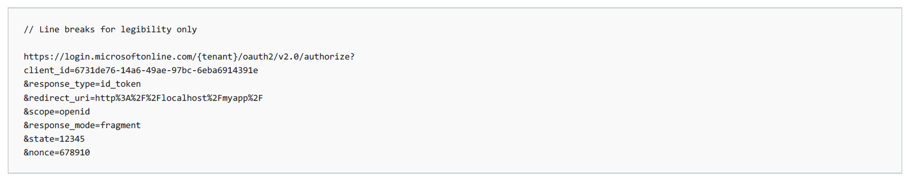
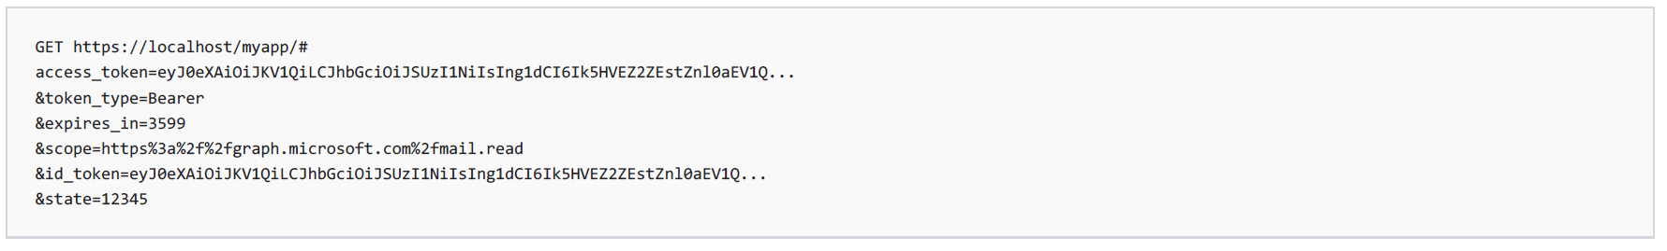
Azure AD Implicit Flow
response_type=id_token token
scope=include scopes requested for Token

Slide 26
Más información:
info@netcoreconf.com
@Netcoreconf
Visítanos en:
2019.Netcoreconf.com
GRACIAS

